Slide 1



ENGLISH LANGUAGE
PLE EXAMINATION PREPAREDNESS TRAINING, 2024
BY: MUKENYE DAVID ---0782012215 / 0752012215

Slide 2
THE ENGLISH LANGUAGE PAPER EXCELLING TIPS IN PREPARATION FOR P.L.E 2024
LESSON ONE
SECTION A
The paper of English comprises two Sections ; A and B
Section A has two sub- sections
Sub-section 1: 30 questions = 30marks
Sub-section 11:
20 questions = 20 marks

Slide 3

SUB-SECTION 1- 30 MARKS
Let’s now have a look at what is tested or asked in Section A ,Sub-section 1;
This will help you know and plan very well to score the 30 marks in this sub-section.
1. GAP FILLING
Candidate should be in position to read and understand the sentence or question.
Candidate should be in position to identify the guide word in the sentence.
Candidate should be in position to tell the subject and object of the sentence.
Train candidates to use simple but understandable words or language.
Candidates should be in position to punctuate the sentences written well.

Slide 4


2.WORD FORMATION / TRANSFORMATION
We put more emphasis on the tense of the sentence: E.g
The naughty boy who a pen from the teacher’s table was punished. (steal)
Let the candidates differeciate the present simple tense from the present continuous
The present perfect from the present perfect continuous.
Let them know the difference between present perfect (has/have)… from past perfect tense (had)….

Slide 5
SHORT FORMS :
You can be asked to write the full forms in short or the short forms in full We need to train the candidates about the standard abbreviations:
b. born
PO THE POST OFFICE
aka also known as
WWW WORLD WIDE WEB
Cc carbon copy
Rev. Reverend
Let the candidate learn about contractions not as abbreviations
We we had /would
Can’t cannot etc.

Slide 6

GROUP WORDS OR ONE WORD FOR MANY
( This is testing the vocabulary you have been learning from different themes or topics from primary one to primary seven)
Examples of themes or topics learnt from primary one – primary seven.
Our home
Our school
Safety at home
Describing people and objects etc.

Slide 7
NUMBER ( SINGULAR AND PLURAL FORMS OF NOUNS
Rewrite the sentence giving the plural form/singular form of the underlined word.
Nouns and pronouns are the ones tested or examined.
Those ending in-y preceded by a consontant.(Drop -y then add ies)
e.g. secretary- secretaries ( P.L.E 2001)county- counties ( P.L.E 2006) lady-ladies ( P.L.E 2007) butterfly-butterfies ( P.L.E 2011)….….diary…… - ……diaries……(P.L.E 2015)

Slide 8
Those ending in-y preceded by a vowel.( Just add letter s) e.g. ……chimney……-……chimneys…( P.L.E 2003)
monkey - monkyes ( P.L.E 2016)
Those ending in -f/-fe e.g myself-ourselves(P.L.E 2005) / wife-wives(( P.L.E 2009) / handkerchief-handkerchiefs ( P.L.E 2010) / wolf-wolves / shelves-shelf(P.L.E 2012) Bookshelf-Bookshelves(P.L.E 2016) etc
Those ending in -x e.g box-boxes(P.L.E 2013) etc

Slide 9
Those ending in -th e.g. cloth-cloths(P.L.E 2006)
Tooth-Teeth(P.L.E 2010)
Compound nouns e.g. head of department(P.L.E 2005)/
brother-in-law(P.L.E 2009)/sister-in-law(P.L.E 2017)
Point of order(P.L.E 2014)
Uncountable nouns e.g. news-news(P.L.E 2008)
Ending in s/es e.g. glass-glasses(P.L.E 2006)/match-matches(P.L.E 2007)/tomato-tomatoes(P.L.E 2011)/buffalo-buffaloes/buffalo(P.L.E 2012)

Slide 10

Possessives e.g.
candidate’s name =candidates’ names (P.L.E 2018)
Lady’s bag = ladies’ bags
Baby’s cot = babies’ cots
Child’s right = children’s rights
Man’s shirt = men’s shirts
Woman’s show = women’s shows
and many others like sheep/deer.

Slide 11
HOMOPHONES
use each of the words in a sentence to show that you know the difference in their meaning
HOMOGRAPHS
Words with the same spelling,sound but different meaning

Slide 12
POINTS TO NOTE WHEN ANSWERING SUCH QUESTIONS.
Each time you are using the given words in a sentence, your sentence MUST have a qualifier or qualifiers; they are the ones to show that your sentence is meaningful. Without it or those qualifiers, you won’t be awarded a mark or marks.
In case one of the given words is a main verb, you advised to avoid transforming or changing that word into another tense; instead use it as an infinitive as given in the question.

Slide 13
e.g. need -( P.L.E 2018) -qualifiers: something such as an object, time, a day, etc.
Knead-(P.L.E 2018) -qualifiers: dough, clay, baker, builder, etc.
Examples in sentences
Wrong: What do you need? (No qualifier)
Correct: I need a pen for writing a composition.
Wrong : We shall knead it tomorrow (No qualifier)
Correct : The baker will knead dough in the evening.
We knead clay before baking bricks.

Slide 14
Practice
Weight (PLE – 2020)
(qualifiers: kilogrammes, heavier than
Wait (PLE – 2020)
(……until…… or ……till………)
Wrong : What is your weight?
Correct: We shall wait for John until he comes.
coat / court - (P.L.E 2001)
flour/ flower - (P.L.E 2005)
luck / lack - (P.L.E 2007)
peace / piece- (P.L.E 2009)
hut / hurt - (P.L.E 2010)
brake / break - (P.L.E 2011)
sea / see - (P.L.E 2014)
fare / fair - (P.L.E 2015)
reed/ read - (P.L.E 2016)
meat / meet - (P.L.E 2017)
lose/loose - (P.L.E 2002)
live / leave - (P.L.E 2003 / 2006)
die / dye - (P.L.E 2003 / 2006)
hear / here - (P.L.E 2012)
sauce / source - (P.L.E 2019)

Slide 15
SENTENCE BUILDING / SENTENCE FORMATION
Rearrange the given words to form a correct/meaningful sentence.
Note: This is where you are required to arrange the given words to form a correct sentence.
STEPS
Read through the words given
Identify the end punctuation mark ( . ? ! )
Use the identified punctuation mark to determine the first word of your sentence.
Number the words until you get to the last one including punctuation mark as well to avoid forgetting it or leaving it out in your final answer

Slide 16
Read through the numbered words to confirm its correctness.
Then write your final answer.
NB: Make sure that you do not leave out any word as numbered.
Finally, read through the just written sentence.
e.g.how to know I ride a bicycle. (P.L.E 2020)
NB. Commonly asked questions can be from;
declarative sentences -.
interrogative sentences -?
exclamatory sentences -!

Slide 17
ALPHABETICAL ORDER
Rearrange the given words in alphabetical / ABC / dictionary order.
NB.
Rearranging by 1st letter
Rearranging by 2nd letter
Rearranging by 3rd letter
Rearranging by 4th letter
Note
If there is a word that has the first letter capital, maintain it.
If no commas, also no commas
If with commas, also have commas in your final arranged answer.

Slide 18
OPPOSITES OF (NOUNS / ADJECTIVES / ADVERBS, VERBS)
In questions 29 and 30, rewrite the sentences giving eh opposite of the underlined word.
NB. Do what the instruction states.
e.g. Rewrite -complete sentences
Give / write – only the answer of course beginning with a small / lower case letter.
Replace – Complete sentence
Examples: Our home is two kilometers after the market ….. before… (P.L.E 2020)
Arthur like staying in urban areas during holidays.
….rural….. (P.L.E 2020)

Slide 19
LESSON TWO
10.SUB SECTION II (STRUCTURES)
(SENTENCE TRANSFORMATION)
(20 questions – (20 marks)
Rewrite the sentences as instructed in the brackets.
These structures are got from structures taught to you from Primary one to primary seven as guided by the curriculum and syllabus.
Advice
Read the main instruction e.g. In each of the questions 31 to 50, rewrite the sentences as instructed in the brackets.
Read the question.
Read the sub instruction as given in the brackets.
The answer the question in accordance with the sub – instruction given in the brackets.

Slide 20
Areas tested here among others include;
Active and passive voice
Direct and indirect speech
Order of adjectives
guided by this acronym
D/NOPSASCOMUPPN
D/N – Determiner/Number – a, an, the, two, few, etc.
OP– Opinion – beautiful, ugly, poor, etc.
S – Size – big, large, tall, short etc.
A – Age – young, old, ancient, modern, ten years etc.
S – Shape-Circular,Conical,Triangular,Spherical etc
C – Colour – black, dark-skinned, light-skinned etc.
O – Origin – Ugandan, Rwandan, Turkman, Turkwoman, Ghanaian etc.
M – Material – gold, woollen, metallic, wooden, cotton,
U/P/P – Purpose/Use/Participle adjective walking, swimming, reading, dining, etc.
N – Noun being described (yesterday etc.)

Slide 21
NB. If the time adverb is in the question, place it after the noun.
Qn. 41 Ssombe has bought a ring. It is made of gold. It is new.it is in form of a circle. (Join without using: and / which (P.L.E – 2020)
RELATIVE PRONOUNS
e.g.
Whose , where, about whom, from whom, with whom, by which, in which, who, whom, etc.
Note:

Slide 22
Common noun subject - no commas required in the answer.
Proper noun subject – two commas are a must in your answer and must be placed rightly.
Common Noun subject
That is the secondary school. My father studied from there. (P.L.E 2020) ((Use: …. where…)
common noun subject= The secondary school ,so no commas required in our answer.
That is the secondary school from where my father studied.

Slide 23
If the preposition is in the question, it must precede or be put before the relative pronoun as underlined above.
If the preposition is in the question, make sure that you do not repeat ahead of your answer.
e.g. That is the secondary school from where my father studied from (wrong)
If the preposition is in the question, do not separate from the relative pronoun given.
e.g. That is the secondary school where my father studied from. (wrong)

Slide 24
Refer to P.L.E 2020
Qn. 43 We worked for an old man yesterday. The old man thanked us. (Use: …. whom….)
Qn. 44 The journalist made a statement at police. His camera was stolen. (Use: …. whose…..)
Okello visited our school today. You met his father last month. (Use: … whose…) (P.L.E 2004)
Okello, whose father you met last month, visited our school.
Mondo will visit our school tomorrow. You met his son last week. (Use ….whose….)

Slide 25
Conjunctions (mixed structures)
….like…..
….prefer…..to….
….either….or….
(same action put it before….either….) (Two different actions , put them after …. either…)
….neither…. nor….
….. such a/an ….that….
…. too…. to …. /….too ….for….to….)
….enough …/ … mor interested … than….) two prepositions of ‘in’ placed before each action )

Slide 26
…, so… / ….. so… that / …. as ….as …/
… as soon as …./ ...as well as … (one subject … no commas) (two different subjects …. two commas each placed before the mentioned subject or noun
No sooner / Hardly had / Scarcely had / Barely had/ …. and neither …. / ……and so …. / …. so that….. / ….so as …. / in order to… / …. in order that…. / ….. would rather … than…. (same action….. no repeating it) / …. more interested…..than… / …..not only….….but also …./ Not only…………but also …../ …. interested…/ Immediately…/Although…/Despite../In spite…/Even though…/…….but…./…..because…/…owner…./while…./
Much as…./ Whereas…./…used to…./…used for…./….just…./Both…./….both…/..after…./…..managed…./………succeeded….

Slide 27
PARALLEL ADJECTIVES/DOUBLE COMPARATIVES
The…….., the………
g) EXLAMATORY STATEMENTS
How……..! / What………! / ……..very…….
The dancers are very skillful.( Begin: How….!) P.L.E 2020)
h)Neccesity and obligation
…..necessary……/ …….needn’t……/
Conditional sentences also known as IF Clauses
….….will….( IF 1)
….….would….( IF 2 )
….….would have…( IF 3)
Question tags

Slide 28
LESSON THREE
SECTION B
This section is made up of comprehension and compositum questions.
The section carries 50 marks.
It has five numbers; each number carries 10 marks.
COMPREHENSION
Comprehension is a noun derived from the verb comprehend which refers to one’s ability to read, understand or interpret a given text, written material or data.

Slide 29
Let’s first look at how we should answer comprehension questions.
It must be answered in a full sentence as required by the question.
Avoid giving clumsy responses or answers.
What is the poem about?
Wrong: The poem was about road accidents in Uganda.
When did the accident take place? (10th May 2022)
Wrong: The accident will take place on 10th May, 2022.
Avoid lifting an answer or idea from the text to your answer

Slide 30
What caused the accident, according to the poem? (Okello was riding the bicycle at a high speed and when he arrived at a corner, he failed to reduce the speed.)
Wrong: Riding the bicycle at a high speed and when he arrived at the corner, he failed to reduce the speed.
Avoid misspelling words in your answer. e.g., names of places and people and any other word in your answer.
Avoid using pronouns in place of given nouns.
e.g. Why did Molly arrive late at school?
She arrived late at school because of traffic jam.

Slide 31
Always give your answers in the tense that has been used in the question.
If the question is in active voice, the answer should not be given in passive voice and the reverse is true.
e.g. Who wrote the poem?
The answer is: John wrote the poem.
By whom was the poem written?
The answer is: The poem was written by John

Slide 32
You must know the requirements for each questioning word e.g.
Who………… requires a person or name
Where……….requires the place
When………...requires time/date/ day
What………requires the fact
How long…requires duration
Why……….requires the reason Which……requires objects/animals/ sometimes persons
How………requires the way expressed using by/through or write a direct response.
For questions that demand numbers as answers, write the numbers in words apart from the exceptions

Slide 33
A question of “How many……?’’ demands a structural response of; “There are/were……” if the question has a formation of a helping verb ┼ a preposition i.e. are in/ were in/ are at/ were at, etc.
Example of such questions
How many pens are in the box?
There are twenty-one pens in the box.
b) How many people were at the party?
There were two people at the party.
However, if the question of “How many……?’’ is written with a main verb and not the helping verb, the response begins with the answer (number) itself.

Slide 34
Example questions
How many candidates sat the mid-term assessment?
Twenty-two candidates sat the mid-term assessment.
b) How many scripts were collected?
One hundred scripts were collected.
Ensure correct spelling of all the words.
Punctuate your answers correctly.
Your handwriting should be legible (readable).
For questions that require you to give, mention, write, state or suggest, you should simply write the answer straightaway.
If the question begins or ends in “according to”, “apart from”, “besides”,etc, you must use the phrase in your answer sentence preferably at the beginning even when it is at the end of the question.

Slide 35
If the question sentence begins with “who/why/when/ etc do you think…?” you must begin your answer sentence with, I think……………” If the question begins with a helping verb like; “Do you think…?” you begin the answer with: No, I don’t think…. /Yes,I think……
When you are required to give another word or group of words with the same meaning as each of the underlined words in the passage, poem, dialogue, etc. (synonym), you must reread the sentence in which the word appears.
A word may have more than one meaning, so if you just look at the underlined word in isolation, you may not give the target answer. In other words, you ought to apply context to the underlined word.
However, if the question is Suggest a suitable title for the passage or poem
PREPARATION FOR AN EXAMINATION

Slide 36
Areas from where comprehension questions are picked.
We have three types of comprehension.
Reading Comprehension
Passages
Poems i.e.They rarely miss
Dialogues/ conversations
Written letters (informal or formal)
Invitation cards
Certificates such as marriage, birth, death, academic etc.
Circulars etc.
Posters (PLE 2002)
Agendum

Slide 37
Interpretation Comprehension
Graphs e.g., travel, bar, line
Pie chart/ Venn diagrams
Maps (PLE 2013)
Tables (PLE 2016-library borrowing table ,etc, (PLE 2016) / (PLE 2008)
Registers (PLE 2014)
Block picture or picture comprehension (PLE 2015)
Family tree
Programmes e.g., Sports and Games(PLE 2015) MDD,etc
Receipts, bank slips, filled forms, bills etc.

Slide 38
Timetables e.g., class timetables, travel or revision timetables (PLE 2011)
, sweeping or duty rotas
Arrival books (PLE 2005)
Calendars
Terminal reports (PLE 2012)
Diaries (PLE 2014)
Health records (PLE 2007, 2014)
Menus
Information Comprehension
Notices (PLE 2001/ 2006/ 2007/ 2008/2010 / 2013/ 2014 )
Advertisements (2007/ 2013/2017)
Announcements

Slide 39
LESSON FOUR
COMPOSITION
Composition is a noun derived from the verb compose. It involves the generation of a piece of text from the given instruction or question. It also involves generation of sentences or statements that correctly fill in the gaps in the text given.

Slide 40
Areas tested or examined in a composition aspect are;
Picture composition(P.L.E2009/2010/2013/2014/2017/2019)
Letter writing
Guided letter filling
Guided story or passage
Punctuating a two-paragraph passage or story.
Disordered or jumbled sentences.
Guided dialogue or conversation filling.
Guided form filing. (Here, you are given a paragraph of information from where you will get what to fill in the gaps.)

Slide 41
FILLING FORMS
N.B: Forms are filled in capital or block or upper-case letters apart from a few exceptions.
Let’s have a look at how to answer a few of these composition questions.
Picture Composition.

Slide 42
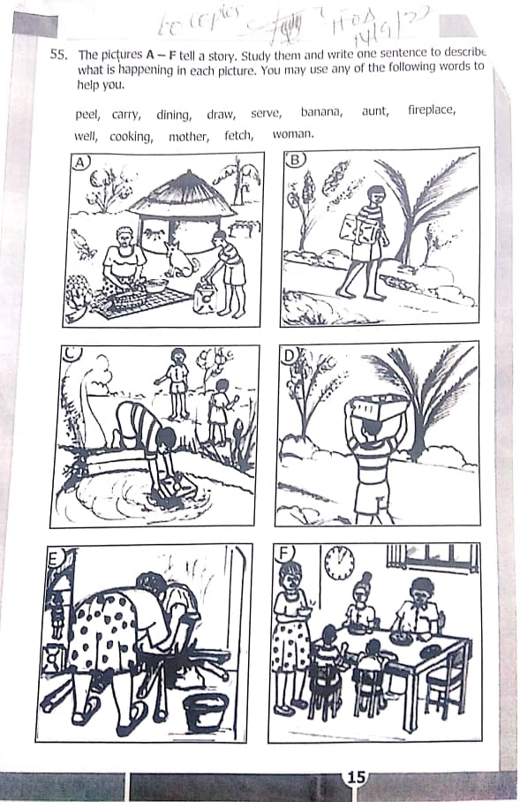

Slide 43
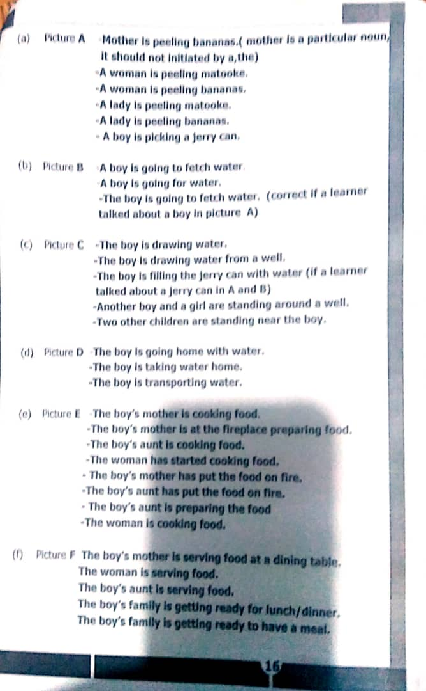

Slide 44
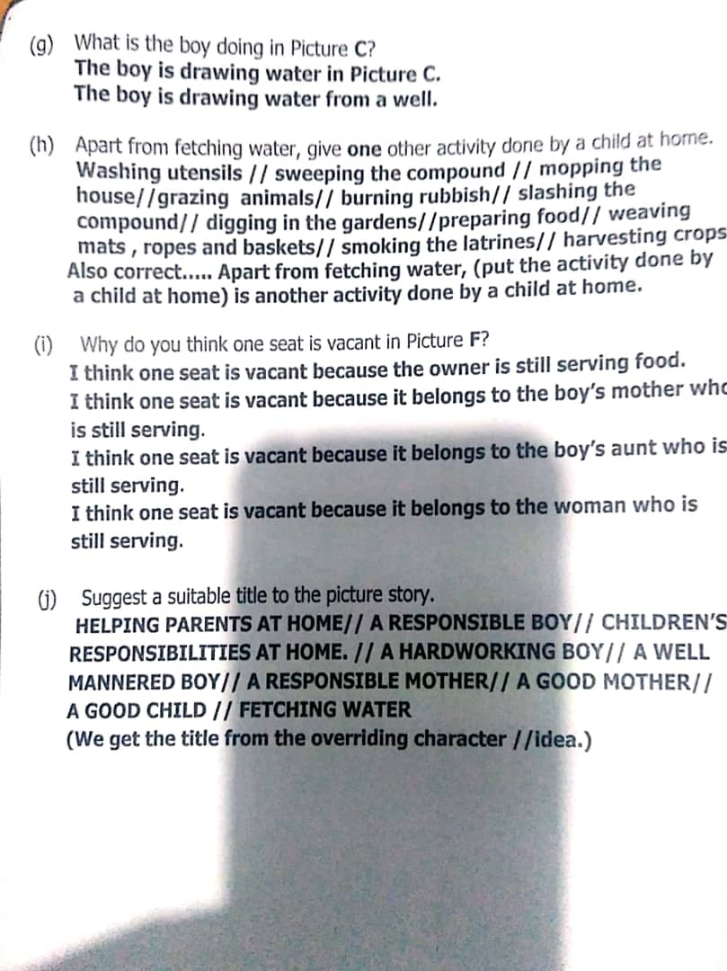

Slide 45
What you must know about picture composition
The tense
Present continuous tense is used to describe pictures that you think their actions are still going.
…….is + are …. ing ……
Present perfect tense used to describe pictures that you think their actions have taken place. E.g., … + has or have + past perfect tense (written….)

Slide 46
The article use.
‘a/ an’ is used when talking or describing the picture or character in the picture which is in singular form for the first mention. A woman is peeling bananas.
‘The’ is used when talking or describing the picture or character in the picture in the second or more mentions.
This article is used in the second or more mentions of characters either in singular or plurals. The woman is peeling bananas.
N.B: When the character to be described is in plural form, for the first mention, do not use any article, not even article ‘the’.

Slide 47
Picture 1: The boys are playing football.
Picture 2: The boys have scored a goal.
Note
Never describe pictures in passive voice.
Never own pictures. E.g., My mother is peeling bananas.
Answer the four comprehensions like any other comprehension not following rules given above. Those rules are only applied when describing pictures 1-6 or picture A-F.

Slide 48
Steps of answering a picture composition questions for you to score 10 out of 10.
Read through the key instruction including the words given to you.
Move on and read the four comprehension questions but without answering them. This may help you get to know some pictures in the story. E.g., Why do you think the head teacher is addressing the school in Picture 2?
Get back and summarize each picture by identifying;
The character

Slide 49
The action carried out
Do this in pencil. e.g.;
Picture A: mother (character)
peel (action)
Picture B: boy (character)
going (action)
Picture C: boy (character)
fetching (action)
Picture D: boy (character)
carry (action)
Picture E : mother or woman (character)
Prepare/cook (action)
Picture F: mother or woman (character)
serve (action)

Slide 50
: When you first choose to talk about mother, then continue with that character whenever you see it in the picture, avoid changing. You can only change if the picture has another character.
Begin describing your picture using your summaries above while putting into use, the knowledge of these and articles.
Finally, answer the four comprehension questions.

Slide 51
LESSON FIVE
Letter writing.
Informal
Writer’s address
Date
Salutation
Body
Introduction/ purpose as I am writing not have written
Main communication in paragraphs. This is the part which talks about in sentence what the question instructs you to talk about.
Conclusion e.g. I look forward to meeting you at the party etc.

Slide 52
Complementary close. This one’s derived from what your salutation looks like e.g.;
Your friend
Your daughter
Your son
Your niece
Your nephew
One writer’s first name e.g.
John
Mary
Rosemary, etc.

Slide 53
Formal letter
Writer’s address
Date
Receiver’s or addressee’s address
N.B: a) The title of the receiver must start with a capital letter.
Salutation.
Dear Sir
Dear Sir/ Madam
Subject line e.g.
Re: APPLICATION FOR …..
Re: PERMISSION TO…..
Re: APOLOGY FOR …..
Re: INVITATION TO…..

Slide 54
N.B: All the above nouns after ‘Re’ are got from the verbs as used in the question.
Body
Introduction/ purpose
Main communication
Conclusion.
Complementary close
Dear Sir
Dear Madam
Dear Sir/ Madam
= yours faithfully/ yours truly
Dear Rev. Peter Olume – yours sincerely.

Slide 55
Writer’s signature (At your level, it is made up of your compound name which can be written beginning with capital letters.) e.g.;
Richard Okello
Mary Namukasa
Writer compound or full name as it appears on the signature but now written in capital letters all through. e.g.,
RICHARD OKELLO
MARY NAMUKASA
Not common but where necessary, the writer’s title is put in brackets e.g. (HEAD PREFECT), (GAMES AND SPORTS PREFECT) etc.
NB; open punctuation is mostly preferred.

Slide 56
COMPOSITION WRITING
Creative/guided writing ‘aka’ Composition Writing.
Basic parts to know.
The title
The introduction
The body
Conclusion
EXAMPLE
In about 100-150 words, write a composition about how you spent your Christmas Holidays. mention where and the people you spent it with. How you prepared for it, the gifts you gave out and received, what excited you most and why.

Slide 57
Title: A MERRY CHRISTMAS WITH FAMILY
*Introduction:*
Over the Christmas holidays, I had a fantastic time with my family, creating
*Body:*
We spent Christmas at our grandparents' house, where the whole family gathered.
Towards Christmas, we decorated the house with twinkling lights and colorful ornaments. I helped my mom bake cookies and wrap presents for everyone.

Slide 58
On Christmas morning, the excitement was palpable as we exchanged gifts. I received a remote-controlled car from my parents and a book set from my older sister. I gave homemade candles to my grandparents and hand-drawn cards to my cousins.
The best part of Christmas was seeing the smiles on everyone's faces and feeling the warmth of togetherness.
*Conclusion:*
In conclusion, my Christmas holidays were filled with love, laughter, and joy. Spending time with family and exchanging heartfelt gifts made it truly special. I can't wait for next year's celebrations!

Slide 59
N.B: Never write, “Written or compiled by…..”
Note: Both in letter writing and in composition writing, mind about;
paragraphs
spellings
punctuation marks
Tense used as used in the question
For only letters, the type of letter written
All the above areas if seen in your work or if well used earn you marks.

Slide 60
I wish all of you success in PLE 2024.
National facilitator and Consultant
MUKENYE DAVID
+256 752012215
Email: mukenyed@gmil.com

